Slide 1

Temperature
And Humidity Monitoring Using
ThingSpeak and Node MCU

Slide 2
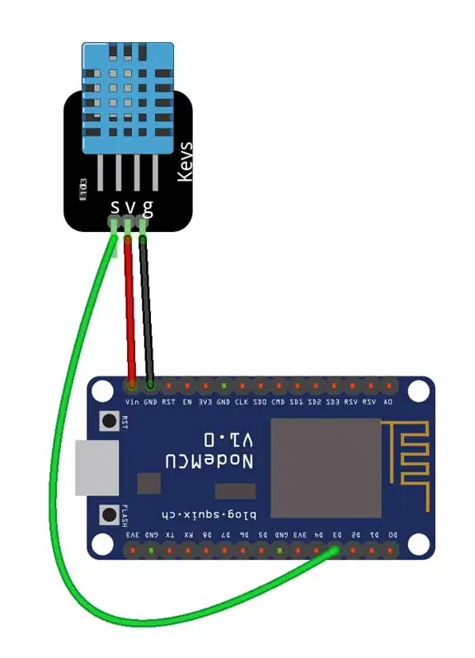
Circuit Diagram

Slide 3
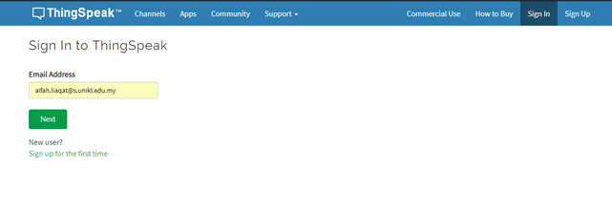
Log-in/Sign-up in ThingSpeak

Slide 4
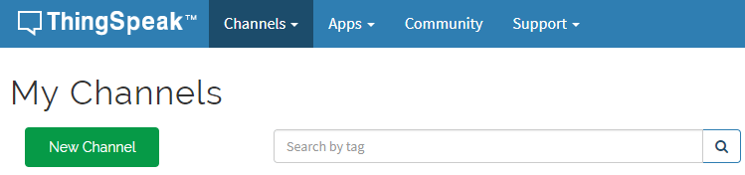
Create a New channel

Slide 5
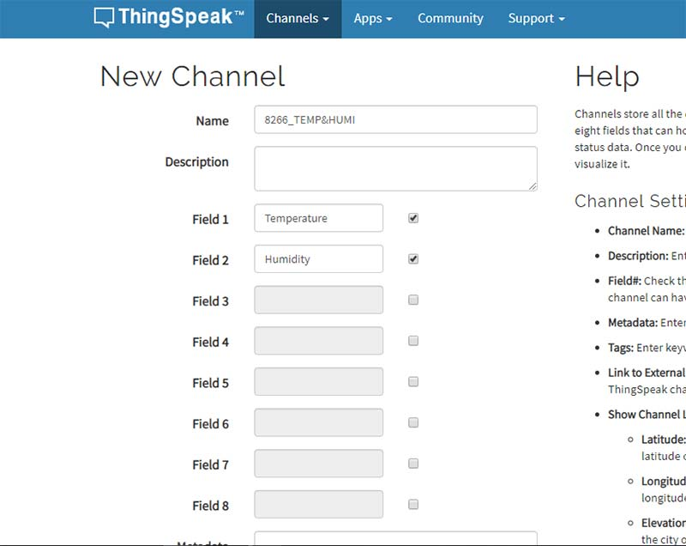
Configure
The Channel

Slide 6
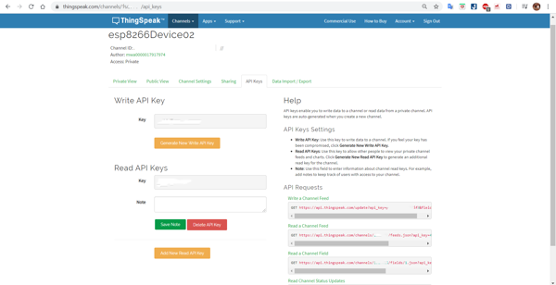
Copy The API (used to connect website and Data from DHT)

Slide 7

Program

Slide 8
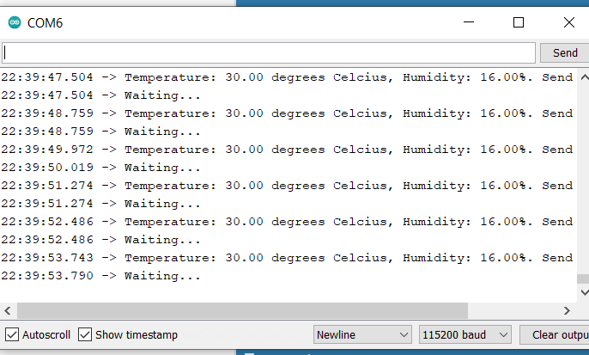
After Uploading Program Click On COM Port To See The Value

Slide 9
To Show The Values , Configure Widget

Slide 10
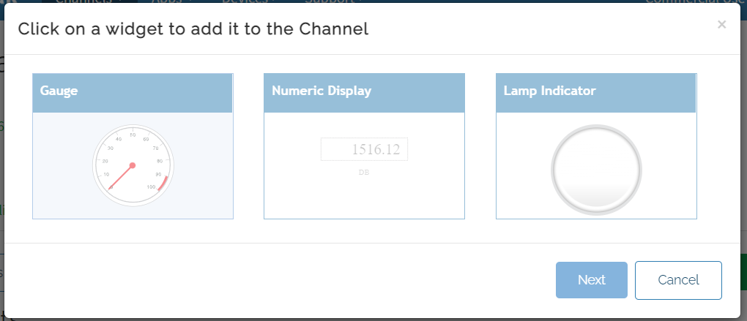
Step 1(Click On Numeric Display)

Slide 11
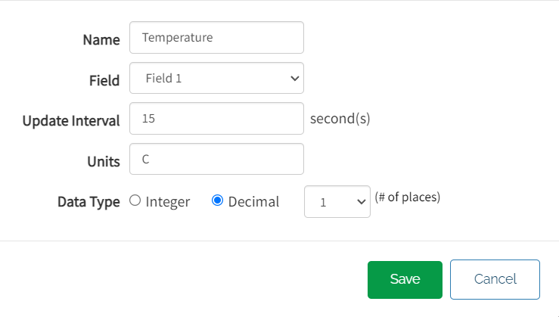
Step 2 ( Configure First Widget For Temperature)

Slide 12
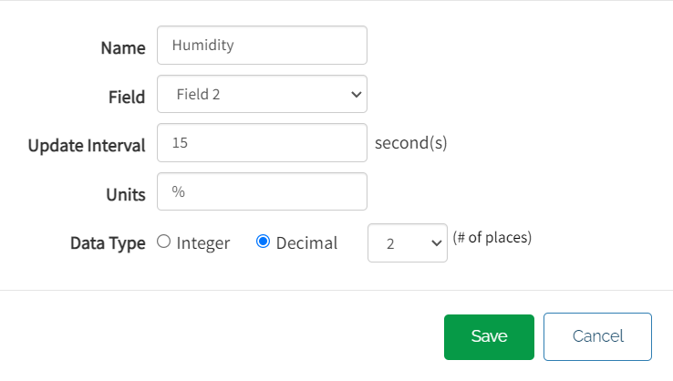
Step 3 ( Configure First Widget For Humidity)

Slide 13
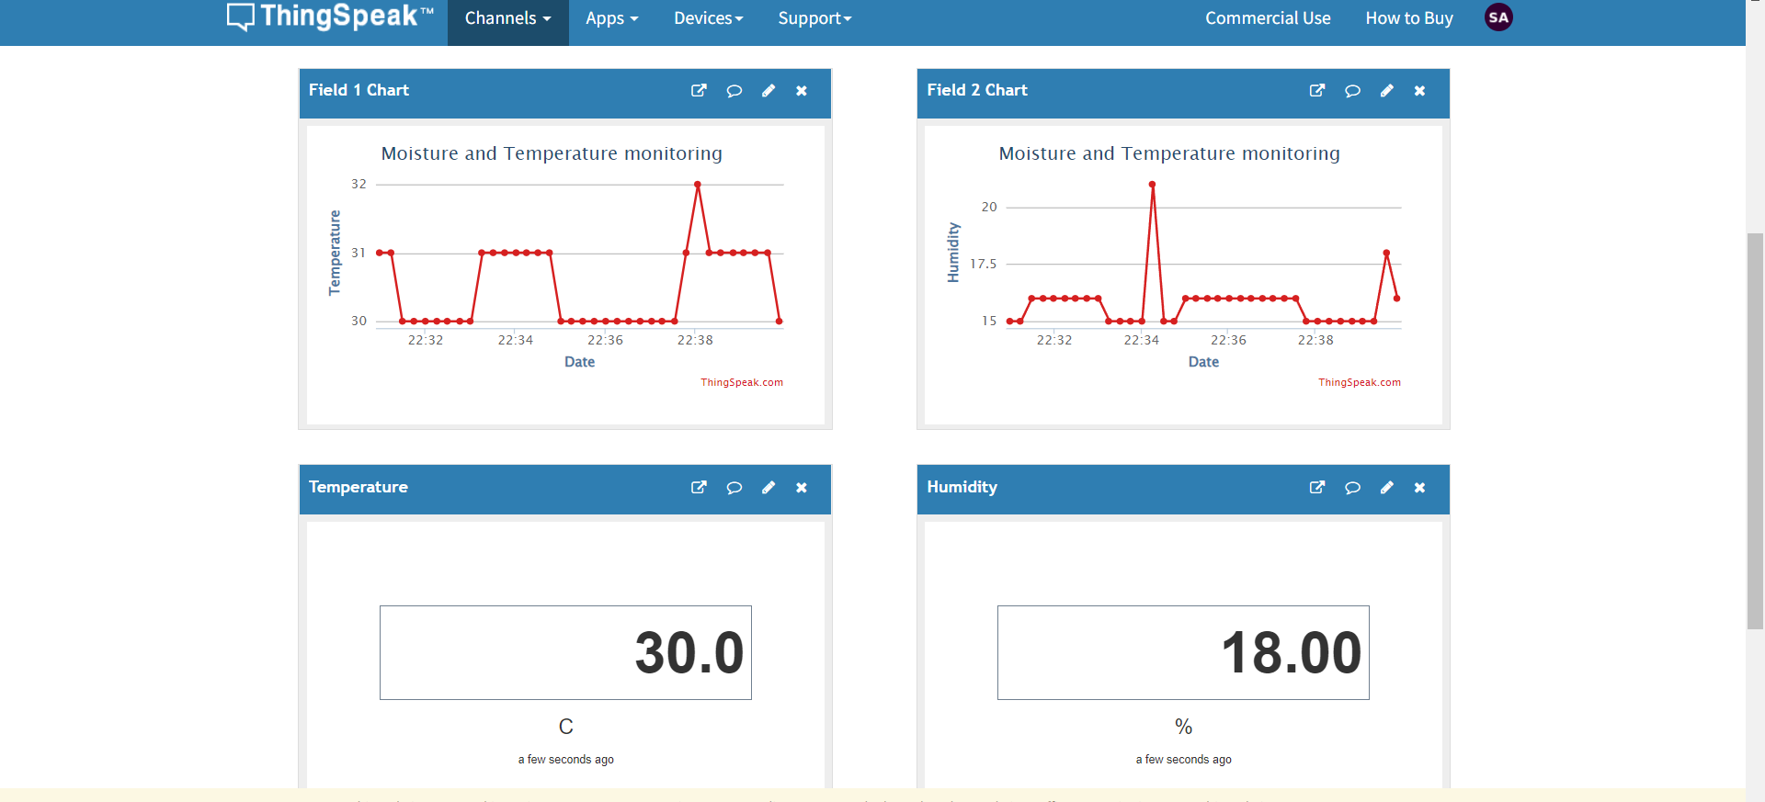
Final Output

